Slide 1
Secure Data Hiding in Image Using Steganography
CAPSTONE PROJECT
Presented By: Mayank Kapoor
College Name : Thakur College of Engineering and Technology, Mumbai.
Department : Artificial Intelligence and Machine Learning (AI&ML)

Slide 2
OUTLINE
Problem Statement
Technology used
Wow factor
End users
Result
Conclusion
Git-hub Link
Future scope

Slide 3
PROBLEM STATEMENT
With increasing digital communication, securing sensitive information is crucial.
Traditional encryption methods protect data but may attract unwanted attention.
Steganography provides a covert way to hide data within images, making it nearly undetectable.
This project aims to develop a secure data-hiding technique using image steganography.
The objective is to ensure confidentiality while maintaining image integrity and preventing unauthorized detection or extraction.

Slide 4
TECHNOLOGY USED
Python – Core programming language for implementing steganography techniques.
Flask – Web framework for building the user interface and handling requests.
OpenCV – Used for image processing and manipulation.
NumPy – Helps with numerical operations and efficient image data handling.
HTML, CSS, JavaScript – Frontend technologies for creating an interactive UI.
Bootstrap – Enhances UI design and responsiveness.

Slide 5
WOW FACTORS
✅ Secure Dual-Layer Protection – Combines steganography with password authentication for enhanced data security.
✅ User-Friendly Web Interface – Simple Flask-based UI for easy encryption and decryption without technical expertise.
✅ Real-Time Processing – Instantly hides and retrieves messages while maintaining the original image quality.
✅ Stealthy & Undetectable – The hidden message remains invisible to unauthorized users, ensuring covert communication.

Slide 6
END USERS
🔹 Cybersecurity Professionals – To securely transmit sensitive information without detection.
🔹 Journalists & Whistleblowers – To share confidential data while avoiding censorship or surveillance.
🔹 Government & Military Agencies – For covert communication and secure data exchange.
🔹 Individuals & Businesses – To protect private messages, credentials, or intellectual property from unauthorized access.

Slide 7
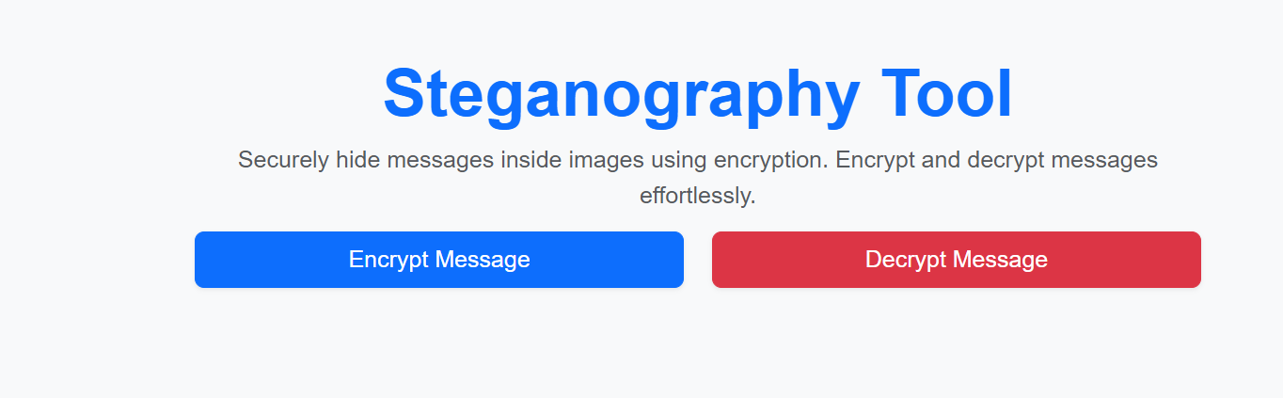
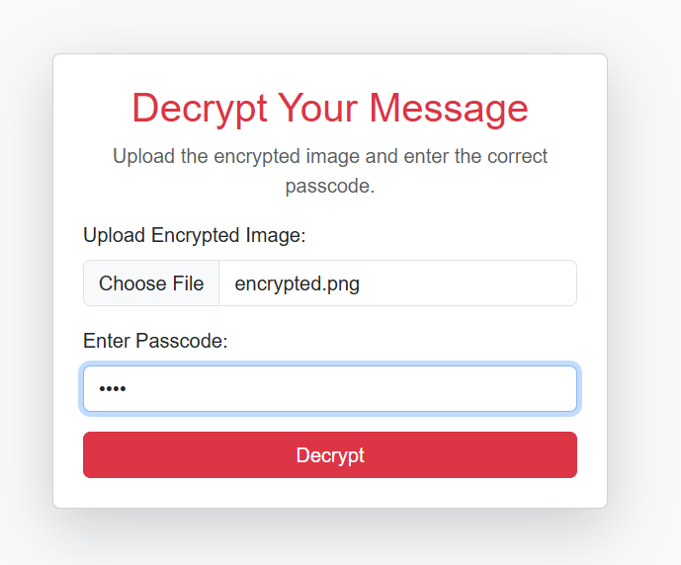
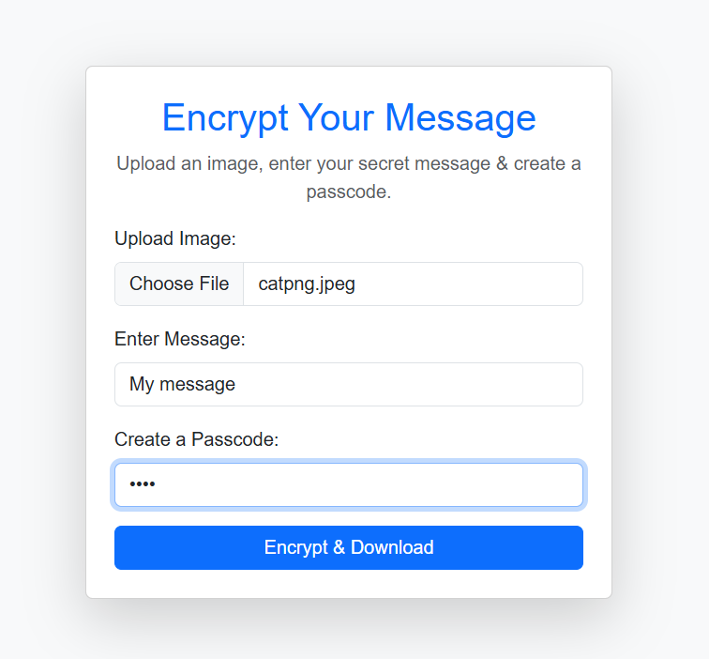
RESULTS

Slide 8
CONCLUSION
Successfully implements image steganography for secure data hiding and transmission.
Combines encryption with password protection, ensuring enhanced security and privacy.
Features a Flask-based web interface, making encryption and decryption user-friendly.
Provides a stealthy and efficient solution, preventing unauthorized detection and access.

Slide 9
GITHUB LINK
GitHub Link to the Project
https://github.com/Mayank030/Secure-Data-Hiding-in-Image-Using-Steganography.git

Slide 10
FUTURE SCOPE
Stronger Encryption – Implementing advanced encryption techniques like AES or RSA for enhanced security.
Support for Multiple File Types – Expanding steganography to hide files like PDFs, audio, or videos.
AI-Based Detection Prevention – Using machine learning to make hidden data more resistant to steganalysis attacks.
Cloud & Mobile Integration – Developing a mobile app and cloud-based storage for secure access anytime, anywhere.

Slide 11
THANK YOU

